Slide 1
제 7 장
Memory - DRAM

Slide 2
7.1 DRAM (Dynamic RAM) 의 특성
- Address Multiplexing
Address must be supplied in row-and-column format
- Dynamic Refresh
All cells in chip must be refreshed periodically
- More complex to interface than SRAM
- Small & Simple Cell Structure
Cost per cell is cheaper

Slide 3
64KB = 2⁽¹⁶⁺³⁾ bit SRAM
64KB SRAM
A15-A0
D7-D0
16 lines
16X2¹⁶
Decoder
16 lines
2¹⁶
2³
2³ lines

Slide 4
64Kb = 2⁽¹⁶⁺⁰⁾ bit DRAM
64Kb DRAM
A7-A0
D0
8X2⁸
latch &
decoder
8 lines
address
8 lines
Array of
memory cells
2⁸ X 2⁸
data
1 line
1 line
8X2⁸
latch &
decoder
timing & control
RAS#
CAS#
WE#

Slide 5
CPU address
A15 – A8, A7-A0
8X2⁸
latch &
decoder
2⁸ X 2⁸
8X2⁸
latch &
decoder
Row address
(A15 – A8)
1 line
timing & control
RAS#
CAS#
WE#

Slide 6
CPU address
A15 – A8, A7-A0
8X2⁸
latch &
decoder
2⁸ X 2⁸
8X2⁸
latch &
decoder
Column address
(A7-A0)
1 line
timing & control
RAS#
CAS#
WE#

Slide 7
8X2⁸
latch &
decoder
2⁸ X 2⁸
8X2⁸
latch &
decoder
Column address
1 line
timing & control
RAS#
CAS#
WE# (0)

Slide 8
8X2⁸
latch &
decoder
2⁸ X 2⁸
8X2⁸
latch &
decoder
Column address
1 line
timing & control
RAS#
CAS#
WE# (1)

Slide 9
64KB = 2⁽¹⁶⁺³⁾ bit DRAM
64KB DRAM
A7-A0
D7-D0
8X2⁸
latch &
decoder
8 lines
8 lines
8X2⁸
latch &
decoder
2³ lines
2⁸ X 2⁸
2³ lines
timing & control
RAS#
CAS#
WE#

Slide 10
8bit CPU (A15-A0) 가 64KB DRAM과 연결 시 기본 회로도
CPU
A15-A0
D7-D0
A15-A8
MUX
64KB DRAM
A7-A0
D7-D0
A7-A0
A7-A0
D7-D0
D7-D0

Slide 11
7.2 일반적인 구성
latch &
decoder
address
lines
data
lines
Array of
memory cells
latch &
decoder
timing & control
RAS#
CAS#
WE#

Slide 12
7.3 Read Timing
RAS#
CAS#
Address
Row
Col
Row
WE#
Data
Data

Slide 13
RAS#
CAS#
Address
Row
Col
Row
WE#
Data
Data
Row access time
- measured from the falling edge of RAS to valid data out

Slide 14
RAS#
CAS#
Address
Row
Col
Row
WE#
Data
Data
Cycle Time
- how fast we can access memory on a continuous basis
some memory need additional time for recovery after an access

Slide 15
RAS#
CAS#
Address
Row
Col
Row
WE#
Data
Data
Column access time
- measured from the falling edge of CAS to valid data out
RAS Precharge time
- required to charge the bit sense lines
for the next memory cycle
Valid data-out window
- the time that valid data remains on the system bus lines

Slide 16
7.4 Write Timing
RAS#
CAS#
Address
Row
Col
Row
WE#
Data
Data

Slide 17
7.5 Refresh
The charge of each cell in DRAM
must be refreshed periodically.
-> 64Kb DRAM의 refresh period : 4msec라 가정하면
4msec당 모든 행들을 refresh
All cells in the row is refreshed at the same time,
by simply applying the row address.

Slide 18
8X2⁸
latch &
decoder
2⁸ X 2⁸
8X2⁸
latch &
decoder
Row address
(A15 – A8)
1 line
timing & control
RAS*
CAS*
WE*

Slide 19
RAS only Refresh
RAS#
CAS#
Address
Row
a row address is sent to the DRAM
all cells in the row are refreshed

Slide 20
8X2⁸
latch &
decoder
2⁸ X 2⁸
8X2⁸
latch &
decoder
Row address
(A15 – A8)
00000000
00000001
00000010
00000011
.
.
11111110
11111111
00000000
00000001
.
1 line
timing & control
RAS#
CAS#
WE#

Slide 21
CAS before RAS Refresh
RAS#
CAS#
DRAM generates internally a row address
and all cells in the row are refreshed

Slide 22
Burst refresh :
the processor is forced into a wait state
and all rows are refreshed in one burst.
-> 64Kb DRAM의 refresh period : 4msec라 가정하면
4msec당 모든 행들을 refresh
Distributed refresh :
the refresh cycles are distributed
over the entire refresh period.
-> 64Kb DRAM의 refresh period : 4msec라 가정하면
4msec/256 = 15.625usec 당 하나의 행을 refresh

Slide 23
8bit CPU (A15-A0) 가 64KB DRAM과 연결 시 기본 회로도
CPU
A15-A0
D7-D0
A15-A8
MUX
64KB DRAM
A7-A0
D7-D0
A7-A0
A7-A0
D7-D0
D7-D0

Slide 24
8bit CPU (A15-A0) 가 64KB DRAM과 연결 시 Refresh 부분 포함 회로도
CPU
A15-A0
D7-D0
A15-A8
64KB DRAM
A7-A0
D7-D0
MUX
MUX
A7-A0
RF
A7-A0
D7-D0
D7-D0

Slide 25
CPU에 의한 Row address의 제공 (정상적인 메모리 이용)
CPU
A15-A0
D7-D0
A15-A8
64KB DRAM
A7-A0
D7-D0
MUX
MUX
A7-A0
RF
A7-A0
D7-D0
D7-D0

Slide 26
CPU에 의한 Column address의 제공 (정상적인 메모리 이용)
CPU
A15-A0
D7-D0
A15-A8
64KB DRAM
A7-A0
D7-D0
MUX
MUX
A7-A0
RF
A7-A0
D7-D0
D7-D0

Slide 27
Refresh 회로에 의한 Row address의 제공 (메모리의 Refresh)
CPU
A15-A0
D7-D0
A15-A8
64KB DRAM
A7-A0
D7-D0
MUX
MUX
A7-A0
RF
A7-A0
D7-D0
D7-D0

Slide 28
DRAM Controller
CPU
A15-A0
D7-D0
A15-A8
64KB DRAM
A7-A0
D7-D0
MUX
MUX
A7-A0
RF
A7-A0
D7-D0
D7-D0

Slide 29
DRAM Controller
CPU
A15-A0
D7-D0
A15-A8
64KB DRAM
A7-A0
D7-D0
RA7-RA0
A7-A0
A7-A0
A7-A0
CA7-CA0
RAS#
R/W#
CAS#
WE#
D7-D0
D7-D0

Slide 30
DRAM Controller
CE#
CE# | BS1 | BS0 | RAS3# | RAS2# | RAS1# | RAS0#
0 | 0 | 0 | 1 | 1 | 1 | 0
0 | 0 | 1 | 1 | 1 | 0 | 1
0 | 1 | 0 | 1 | 0 | 1 | 1
0 | 1 | 1 | 0 | 1 | 1 | 1
1 | X | X | 1 | 1 | 1 | 1
RAS3#
R/W#
RAS2#
RAS1#
BS1
RAS0#
BS0
CAS#
RA7-RA0
A7-A0
CA7-CA0
WE#
RA : Row Address
CA : Column Address
BS : Bank Select
CE : Chip Enable
WE : Write Enable
Row/Column Address 8bit, Bank Select 2bit

Slide 31
CPU
A19
A19
CE#
A18
A18
A17
RAS3#
A16
R/W#
RAS2#
A15-A8
RAS1#
A17
BS1
RAS0#
A16
BS0
CAS#
A7-A0
RA7-RA0
D7-D0
A7-A0
CA7-CA0
WE#
R/W#

Slide 32
64Kb
DRAM
7
64Kb
DRAM
0
RAS3#
RAS3#
D7
D0
CE#
RAS3#
64Kb
DRAM
7
64Kb
DRAM
0
R/W#
RAS2#
RAS1#
RAS2#
RAS2#
BS1
RAS0#
D7
D0
BS0
CAS#
64Kb
DRAM
7
64Kb
DRAM
0
RA7-RA0
A7-A0
RAS1#
RAS1#
CA7-CA0
D7
D0
WE#
64Kb
DRAM
7
64Kb
DRAM
0
RAS0#
RAS0#
D7
D0

Slide 33
7.6 DRAM의 종류
-> (a). FPM (Fast Page Mode) DRAM
RAS#
CAS#
Address
Row
Col
Col
Col
Col
WE#
Data
data
data
data
data

Slide 34
8X2⁸
latch &
decoder
2⁸ X 2⁸
8X2⁸
latch &
decoder
Row address
(A15 – A8)
1 line
timing & control
RAS#
CAS#
WE#

Slide 35
8X2⁸
latch &
decoder
2⁸ X 2⁸
8X2⁸
latch &
decoder
Column address
1 line
timing & control
RAS#
CAS#
WE#

Slide 36
(b). EDO (Extended Data Output) DRAM
- extends the output (latch 이용)
- CAS# (active -> inactive) :
CAS# (inactive -> active) : current data disable, next data enable
- CAS#가 Active되어있는 시기뿐만 아니라
Precharge 되어있는 구간에서도 데이터 출력
-> precharge time을 일찍 시작할 수 있음
cycle time을 줄일 수 있음

Slide 37
RAS#
CAS#
Address
Row
Col
Col
Col
Col
WE#
Data
(EDO mode)
data
data
data
data
Data
(page mode)
data
data
data
data

Slide 38
CAS#
Data (page)
Data (EDO)
Page mode에서 CAS*의 활성영역을 줄이면 Valid data-out window이 줄어듬
CAS#
Data (EDO)
EDO mode에서 CAS*의 활성영역을 줄일 수 있음 :
Valid data-out window 가 충분하기 때문에

Slide 39
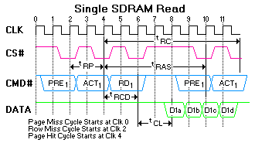
(c). SDRAM (Synchronous DRAM)
- Synchronous DRAM으로 일반적인
DRAM과 (Asynchronous DRAM)는 달리
외부 CLK에 동기 되어 동작하므로 SDRAM이라고 하며,
CLK의 Rising Edge에 동기 되어
모든 동작이 일어 나게 된다.

Slide 40
T1
T2
T3
T4
T5
T6
T7
T8
T9
CLK
CS#
RAS#
CAS#
WE#
Address
Row
Column
Dout
Out0
Out1
Out2
Out3
CAS Latency
Burst Read with CL=2 and BL (Burst Length) = 4

Slide 41
T1
T2
T3
T4
T5
T6
T7
T8
T9
CLK
CS#
RAS#
CAS#
WE#
Address
Row
Column
Din
In 0
In 1
In 2
In 3
Burst Write

Slide 42
(d). DDR (Double Data Rate) SDRAM
- lets two bits of data per cycle transmit between memory and the CPU
- uses double edge clocking
- SDRAM의 Data 입출력은 clock의 Positive Edge를 기준
- DDR은 Positive Edge 및 Negative Edge를 모두 활용
- 현재 main memory로 제일 많이 사용
SDRAM
Out0
Out1
Out2
Out3
DDR SDRAM

Slide 43
T1
T2
T3
T4
T5
T6
T7
T8
T9
CLK
CS#
RAS#
CAS#
WE#
Address
Row
Column
Dout
CAS Latency
Burst Read with CL=2 and BL (Burst Length) = 4

Slide 44
DDR SDRAM (DDR333, DDR400, DDR500)
- DDR333 or PC2700 (named with bandwidth) : 2.7 GBytes/sec
- 166MHz 64bit parallel data path
- transfer two bytes per clock edge (333 MHz I/O rate)
double edge clocking
- peak data transfer data rate
166M X 2 X 8Bytes = 2.7 GBytes/sec
- DDR400 or PC3200
- 200MHz 64bit parallel data path
- transfer two bytes per clock edge (400 MHz I/O rate)
double edge clocking
- peak data transfer data rate
200M X 2 X 8Bytes = 3.2 GBytes/sec
- DDR500 or PC4000
- 250MHz 64bit parallel data path
- transfer two bytes per clock edge (500 MHz I/O rate)
double edge clocking
- peak data transfer data rate
250M X 2 X 8Bytes = 4.0 GBytes/sec

Slide 45
7.7 DRAM Module
DIP (Dual In Package)
- 메인보드 위에 이미 마련되어 있는 홈에 DRAM을 직접 끼워 넣는 방식
- 8086, 8088, 80286의 메인 메모리, 그래픽카드의 비디오 메모리
SIMMs (Single Inline Memory Modules)
- 통일된 규격의 기다란 막대형태의 기판 위에 DRAM을 장착하고
메인 보드에 마련된 소켓 위에 막대 기판을 끼우는 방식
- chips are soldered to minimize the amount of space.
- 기판의 한쪽 면만을 이용
- 8M X 32 (32MB) 72pin SIMM
DIMMs (Double Inline Memory Modules)
- 기판의 양쪽 면을 이용
both-side pins of a board are used to accommodate
the 64-bit (8-byte) data bus width of the Pentium processors
- 8 bytes are provided per DIMM module with 168 pins (84-84 pin)
- 168pins (SDRAM), 184 pins (DDR SDRAM)

Slide 46


30핀 SIMM
- 8bit 의 data bus
- 80286에서 사용 (30핀 SIMM 2개 사용)
- 80386, 80486에서 사용 (30핀 SIMM 4개 사용)
- 1MB, 2MB, 4MB, 8MB
72핀 SIMM
- 32bit 의 data bus
- Pentium, Pentium Pro에서 사용 (72핀 SIMM 2개 사용, EDO까지 지원)
- 8MB, 16MB, 32MB

Slide 47

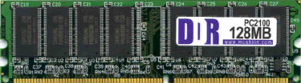
168핀 DIMM
- 64bit 의 data bus (SDRAM)
- 8MB, 16MB, 32MB, 64MB, 128MB
184핀 DIMM
- 64bit 의 data bus (DDR SDRAM)
- PC2100 128MB, 256MB, 512MB
- PC2700 256MB, 512MB, 1GB
- PC3200 256MB, 512MB, 1GB, 2GB

Slide 48
7.8 Interleaving
- A method to improve the performance of DRAM
- Design the memory subsystem using multiple memory
banks, and store data alternatively
: overlap pre-charging and accessing
previous
access
Memory Bank 0
Pre-charging
CPU
Memory Bank 1
current
access
Memory Bank n

Slide 49
ex) 64bit CPU
- First bank (Bank 0) : stores bytes 0-7, 16-23, 32-39
- Second bank (Bank 1) : stores bytes 8-15, 24-31, 40-47
previous
access
Memory Bank 0
CPU
Pre-charging
Memory Bank 1
current
access

Slide 50
Processor typically accesses memory in sequential order,
the first access comes from Bank 0 and the second access
comes from Bank 1
- allows Bank 0 DRAMs to be pre-
charged while Bank 1 is accessed, and vice versa.
- The memory subsystem can operate at the DRAM row
access rate rather than the cycle time rate.

Slide 51
7.9 CPU와 DRAM의 Peak Transfer Rate의 비교
Pentium IV
- 800 MHz System Bus :
Processor Core Speed
3.20 GHz, 3 GHz, 2.80 GHz, 2.60 GHz, 2.40 GHz
Peak data transfer data rate : 800M X 8Bytes/sec = 6.4GBytes/sec
- 533 MHz System Bus :
Processor Core Speed
3.06 GHz, 2.80 GHz, 2.66 GHz, 2.53 GHz, 2.40 GHz, 2.26 GHz
Peak data transfer data rate : 533M X 8Bytes/sec = 4.2GBytes/sec
- 400 MHz System Bus :
Processor Core Speed
2.60 GHz, 2.50 GHz, 2.40 GHz, 2.20 GHz, 2 GHz
Peak data transfer data rate : 400M X 8Bytes/sec = 3.2GBytes/sec

Slide 52
CPU
Processor
Core
Cache
System Bus
(FSB : Front Side Bus)
2.6 GHz
400 MHz
DDR (Double Date Rate)
QDR (Quad Date Rate)
- Clock Speed : 100 MHz
- System Bus Speed : 400 MHz

Slide 53
DDR SDRAM (DDR333, DDR400, DDR500)
- DDR333 or PC2700 (peak I/O rate = 333Mbps)
- 166MHz 64bit parallel data path
- peak data transfer data rate
166M X 2 X 8Bytes = 2.7 GBytes/sec
- DDR400 or PC3200 (peak I/O rate = 400Mbps), 256Mb, 512Mb
- 200MHz 64bit parallel data path
- peak data transfer data rate
200M X 2 X 8Bytes = 3.2 GBytes/sec
- DDR500 or PC4000 (peak I/O rate = 500Mbps), 256Mb, 512Mb
- 250MHz 64bit parallel data path
- peak data transfer data rate
250M X 2 X 8Bytes = 4.0 GBytes/sec

Slide 54
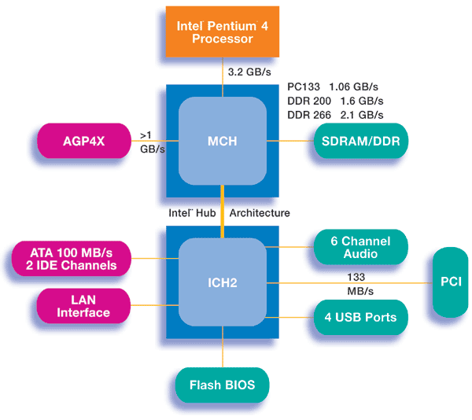
Pentium IV, 400 MHz System Bus (FSB : Front Side Bus) 의
BW ( Bandwidth : 대역폭 ) = 400M X 8 = 3.2GBytes/sec
Memory : DDR266 DIMM의 BW = 266M X 8Bytes/sec = 2.1 GBytes/sec

Slide 55
Pentium IV :
533 MHz System Bus (FSB : Front Side Bus) 의
BW = 533M X 8 = 4.2GBytes/sec
Memory :
DDR333 DIMM의 BW
= 333M X 8Bytes/sec = 2.7 GBytes/sec

Slide 56
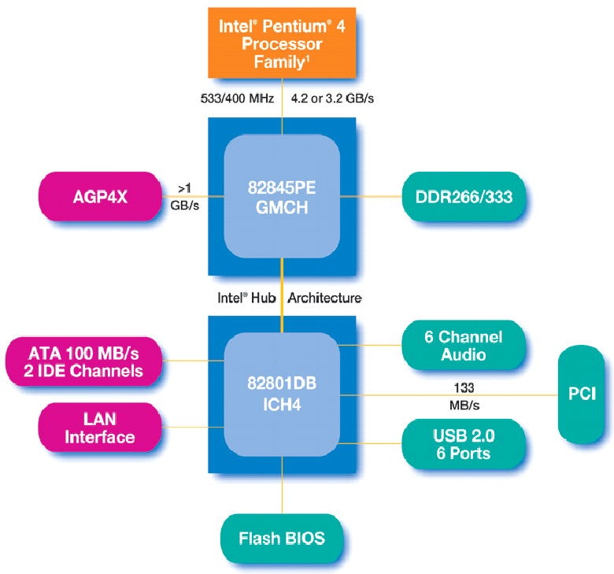

Slide 57
Pentium IV :
800 MHz System Bus (FSB)
BW = 800M X 8 = 6.4 GBytes/sec
Memory :
DDR400 DIMM의 BW
= 400M X 8Bytes/sec = 3.2 GBytes/sec
Dual Channel DDR의 경우 BW
= 3.2 GBytes/sec X 2 = 6.4 Gbytes/sec

Slide 58
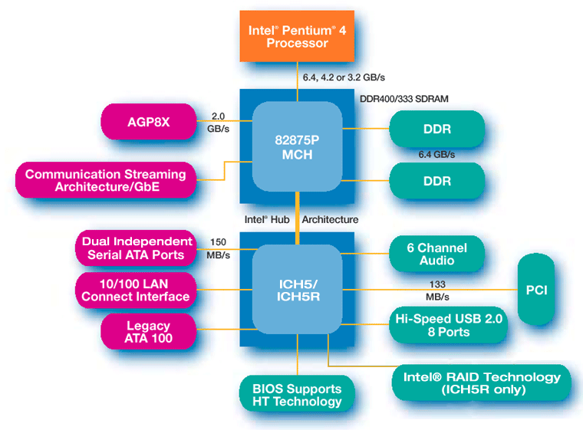

Slide 59
- DDR500 or PC4000 (peak I/O rate = 500Mbps)
- 250MHz 64bit parallel data path
- peak data transfer data rate
250M X 2 X 8Bytes = 4.0 GBytes/sec
Dual Channel DDR : 8.0 Gbyte/sec
- 1G FSB 지원 : 1G X 8Byte

